Slide 1
Center for Army Analysis Pandemic Analysis for Senior Leaders (CAA PANDAS)
MORS David Rist Prize Presentation
21 June 2021
Distribution Statement: This presentation is unclassified, approved for public release, distribution unlimited, and is exempt from U.S. export licensing and other export approvals under the International Traffic in Arms Regulations (22 CFR 120 et seq.)
MAJ Scott Lynch
Scott.a.lynch.mil@mail.mil
703-806-5389

Slide 2





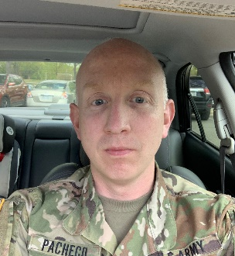
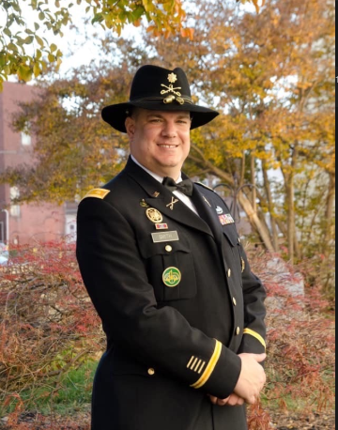



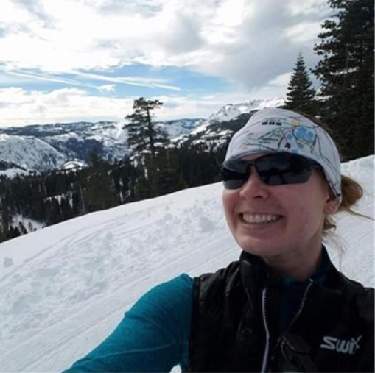
The Project Team
MAJ Maxine Drake | Mr. Collin Henley | MAJ Sandra Jackson | MAJ Scott Lynch | Mr. Kyle Minor | MAJ Matthew Pacheco
Project Management Model Development | Academic Research Model Development | Project Management | Customer Interaction and Project Direction | Customer Interaction and Project Direction | Academic Research
.
MAJ Harvey Smith | MAJ Dusty Turner | Mr. Robert Ward | Mr. Michael Warme | Ms. Michaela Zuber
Indo-Pacific Analyst | Team Leader: Model Development | Model Development | Academic Research | Validation & Verification
Operations Researchers and Analysts make up the project team. At any time, the team was fewer than nine personnel and typically had five team members.

Slide 3
Problem Statement and Research Questions
Problem Statement: Senior leaders across the breadth of the Army, Joint, and DoD enterprise need to understand the impact of Coronavirus Disease 2019 (COVID-19) and make well-informed decisions.
Evolution of Analytical Objectives Over Time
Chapter 2
Chapter 1
Where/when might national/state/local authorities alter mitigation policies as a result of changes in COVID-19 community prevalence?
Where/when will local medical infrastructure become stressed by anticipated COVID-19-related demand?
When and where can government entities resume training with partners and allies?
What non-pharmaceutical interventions best slow the spread of COVID-19 at Army bases?
What is the risk of importing a case under various individual deployment scenarios?
How should the arrival quarantine procedures change for individual vaccinated deployers?
How many medical supplies should staffs order for Military Treatment Facilities (MTFs)?
Chapter 3
What is the best testing policy for units going to Combat Training Center (CTC) exercises?
What is the risk of a COVID-19 outbreak at a deployed location?
Breadth of Impact
Mar
Apr
May
Jun
Jul
Aug
Sep
Oct
Nov
Dec
Jan
Feb
2020
2021
Notes:
The severe acute respiratory syndrome associated coronavirus-2 (SARS-CoV-2), which causes novel coronavirus disease 2019 (COVID-19), emerged toward the end of 2019 in Wuhan, China. The severity of COVID-19 and the apparent high transmissibility caused international concern for the potential of a global pandemic.
During February 2020, increasing numbers of confirmed novel COVID-19 cases in the United States accelerated national- and state-level concerns regarding risk mitigation. The Director of the Center for Army Analysis (CAA) anticipated Army senior leader interest in understanding disease evolution dynamics in the U.S. population and commissioned analytic efforts to contextualize COVID-19 among analogous viral respiratory illnesses through an organizational competition. For this competition, CAA analysts created a Susceptible, Exposed, Infected, Removed (SEIR) model to forecast COVID-19 cases. These analysts would form the core of the project team.
As national- and state-level leadership began implementing COVID-19 risk mitigation strategies to slow the spread of disease within the United States, Army senior leaders issued guidance to reduce risk to force and mission while preparing for responsive assistance to civil authorities. During this time, Army senior leaders requested direct analytic support from CAA.
By the end of March 2020, CAA’s SEIR model gained traction because of the project team's responsiveness to senior leader questions. The Vice Chief of Staff of the Army declared CAA’s model the standard for the Army enterprise and CAA’s project team leader the head of COVID-19 modeling across the Army.
In April 2020, CAA began presenting SEIR model insights and results to Army senior leaders, increasing appetite for the model results in various commands. Chapter 1 will address the SEIR forecast model and these relationships.
In the summer of 2020, the project team began to create projection models in order to respond to specific policy questions from various commands across the Army. Chapter 2 will address various SEIR projection models and their associated customer relationships, while Chapter 3 will address an agent-based projection model and its associated customer relationships.

Slide 4
Chapter 1: Developing a Model that Informed DoD Response to an Emerging Pandemic

Slide 5
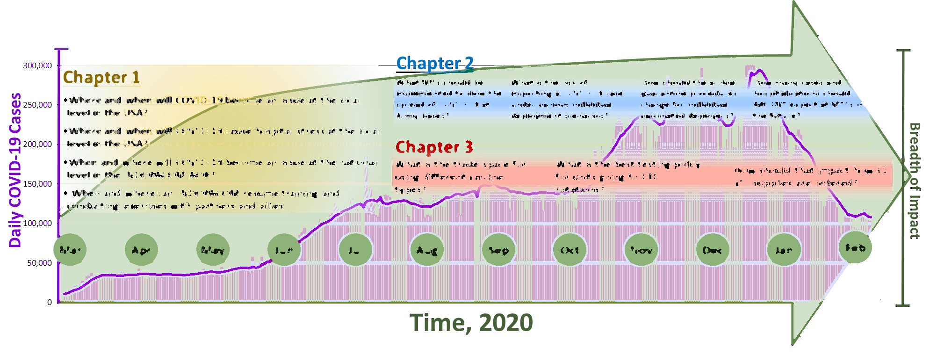
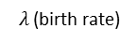
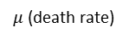
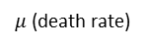
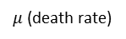
Objectives and Analytical Framework: Research Questions and the SEIR Model
Consumers of CAA analysis
G-3/5/7, Headquarters, Department of the Army (HQDA)
Army Materiel Command (AMC)
U.S. Army North (USARNORTH)
U.S. Army Corps of Engineers (USACE)
Federal Emergency Management Agency (FEMA)
U.S. Indo-Pacific Command (USINDOPACOM)
White House COVID-19 Task Force
Defense Threat Reduction Agency (DTRA)
Chapter 1
Where/when might national/state/local authorities alter mitigation policies as a result of changes in COVID-19 community prevalence?
Where/when will local medical infrastructure become stressed by anticipated COVID-19-related demand?
When and where can government entities resume training with partners and allies?
Analytical Framework: SEIR Model
$λ$(birth rate)
S(t)
E(t)
I(t)
U(t)
Susceptible: As-yet unaffected by virus
Exposed: Incubating, not yet contagious
Infected: Contagious virus carriers
Removed: No longer susceptible, post-infected individuals
$μ$(death rate)
$μ$(death rate)
$μ$(death rate)
$μ$(death rate)
5
Notes:
Modeling Approach: CAA developed a Susceptible-Exposed-Infected-Removed (SEIR) model to project future cases. The model runs for each county in the U.S. and 53 countries in the U.S Indo-Pacific Command area of responsibility, with an option to run for groups of counties that make up metropolitan areas. A SEIR model is among a set of standard epidemiological modeling approaches called compartmental population models. Compartmental population models decompose the totality of the populace into discrete compartments that characterize an individual’s progress through disease phases; a set of ordinary differential equations dictates movement from one compartment to the next relative to time. The bins redefined are:
Susceptible: Proportion of population at-risk of becoming infected.
Exposed: Proportion of population incubating COVID-19 but not yet contagious.
Infected: Proportion of contagious carriers of COVID-19, whether symptomatic or not.
Removed: Proportion of population for whom infection has ended; made up of fatalities and recoveries.
Methodology: The project team executed a four-step process, which this chapter will discuss, to forecast for each population.
Develop code that automatically downloads and consolidates daily over 20 datasets.
Model Initialization: Build a parametric model for the basic reproduction rate ($R_{eff}$) and set deterministic initial conditions given data and parameter values.
Model Execution: Time-step discretization of ordinary differential equation system.
Medical Infrastructure Demand Inference: Decomposition of the predicted COVID-19 cases to estimate stress on local medical infrastructure.

Slide 6
Modeling Assumptions: Standard Epidemiological Assumptions for the SEIR Model
The population within the discrete compartments accounts for the totality of a geographically bounded population.
The total population intermixes uniformly regardless of compartment; geographically distinct populations do not intermix.
The size of every population is static, meaning there are zero births, deaths, and cross-border movements.
Susceptible: As-yet unaffected by virus
All members of the population are equally susceptible to infection.
The distribution of the infected compartment population among age cohorts is proportional to that of the total population.
Demand for hospitalization manifests only while an individual is infected.
The Coronavirus is equally infectious for any given geographic population.
Uniform behavior and interaction of infected individuals regardless of whether an individual is symptomatic or hospitalized.
Recovered individuals are immune and are no longer susceptible.
Exposed: Incubating, not yet contagious
Infected: Contagious virus carriers
Removed: No longer susceptible, post-infected individuals
Notes:
The project team assessed the SEIR approach to reflect COVID-19 dynamics because
1. the populace lacks widespread pre-existing immunity and there is no available effective vaccine;
2. the disease has by a relatively long (5-7 days) asymptomatic, non-contagious incubation period and communal spread patterns (hence, choosing a model that included the Exposed bin);
3. individuals who contract COVID-19 obtain temporary immunity through recovery, thereby rendering the probability of rapid re-infection to be statistically insignificant; and
4. COVID-19’s contagious period is finite, concluded by either recovery or case-fatality.
A population is defined as all people from one modeled region. In CAA’s model, a region is an individual county. CAA takes population size of each county from the U.S. Census Bureau.
Combined, these assumptions describe an abstract world in which human behavior and interaction within a region are always uniform. Also, populations are distinct, and there is no cross-border interaction or movement.

Slide 7
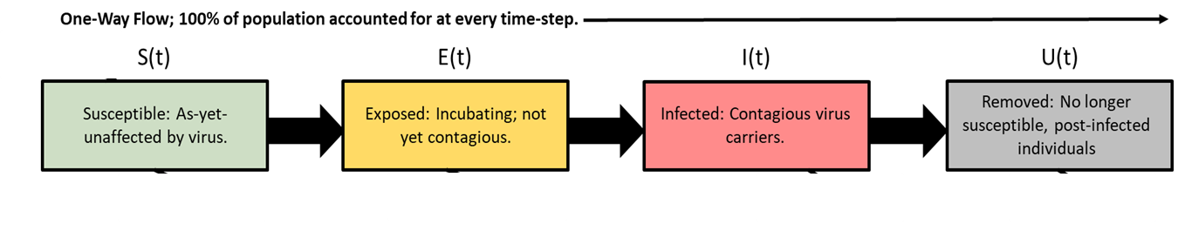
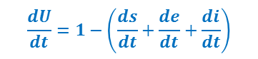

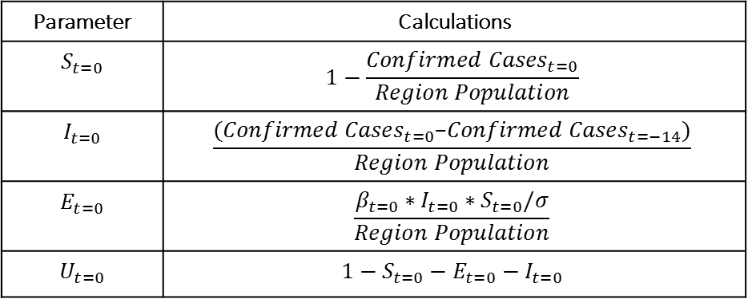

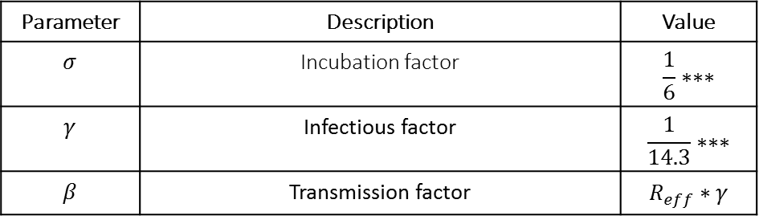
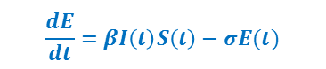
Modeling Formulation: The SEIR Model Ordinary Differential Equations, Variables, and Parameters
S(t)
E(t)
I(t)
U(t)
Susceptible: As-yet unaffected by virus
Exposed: Incubating, not yet contagious
Infected: Contagious virus carriers
Removed: No longer susceptible, post-infected individuals
$$\frac{dS}{dt}= −βI\left(t\right)S\left(t\right)$$
$$\frac{dE}{dt}=βI\left(t\right)S\left(t\right)−σE(t)$$
$$\frac{dI}{dt}=σE\left(t\right)− γI\left(t\right)$$
$$\frac{dU}{dt}=1−\left(\frac{ds}{dt}+\frac{de}{dt}+\frac{di}{dt}\right)$$
Where, $S\left(t_{j}\right)+E\left(t_{j}\right)+I\left(t_{j}\right)+U\left(t_{j}\right)=1$ and $\frac{ds}{dt}+\frac{de}{dt}+\frac{di}{dt}+\frac{du}{dt}=0$
Model Parameters
Model Initial Conditions
Parameter | Description | Value
$$σ$$ | Incubation factor | $$\frac{1}{6}∗∗∗$$
$$γ$$ | Infectious factor | $$\frac{1}{14.3}∗∗∗$$
$$β$$ | Transmission factor | $$R_{eff}∗γ$$
Parameter | Calculations
$$S_{t=0}$$ | $$1−\frac{{Confirmed Cases}_{t=0}}{Region Population}$$
$$I_{t=0}$$ | $$\frac{{(Confirmed Cases}_{t=0}\text{−}{Confirmed Cases}_{t=−14})}{Region Population}$$
$$E_{t=0}$$ | $$\frac{β_{t=0}∗I_{t=0}∗S_{t=0}/σ}{Region Population}$$
$$U_{t=0}$$ | $$1−S_{t=0}−E_{t=0}−I_{t=0}$$
$R_{eff}$ is the effective or observed basic reproduction rate given human and environmental factors
Notes:
A SEIR model is governed by a set of ordinary differential equations. The derivatives represent how quickly the population moves through the SEIR compartments. Since the project team assumed the total population was static, the sum of the derivatives is zero. Since each variable represents a proportion of population, the sum of the variables would always be one.
To initialize a SEIR model, one must (1) assign parameter values (i.e., $σ$, $γ$, and $β$) and (2) assign the initial proportions in each of the four SEIR bins (i.e., $S_{0}, {E_{0}, I}_{0},$ and $U_{0}$).
The parameters are defined as:
Incubation factor, $σ$: the inverse of the length of time (in days) before an exposed individual becomes contagious.
Infectious factor, $γ$: the inverse of the length of time (in days) before an exposed individual becomes contagious.
Transmission Factor, $β$: the inverse of the mean time (in days) between successive exposures of susceptible individuals by a single contagious individual. This can be thought of as how contagious a disease is at a given time.
For $σ$ and $γ$, the project team used Centers for Disease Control and Prevention estimates. The project team continued to experiment with various values of $σ$ and $γ$ only to find that the other values did not result in significantly better case-projection accuracy than the CDC’s estimates.
When examining the differential equations, daily new cases can be thought of as -$\frac{dS}{dt}$, which is dependent on the number of infected people, the number of susceptible people and the strength of the transmission factor. The closer any of these values is to zero, the smaller the value of daily new cases is in that area.
To assign starting values (at $time=0$) to each of the four SEIR bins, the project team interpolated values from the Johns Hopkins University (JHU)COVID-19 case data. JHU case data only provides daily number of total cumulative cases. Note that all $S_{i}, E_{i}, I_{i},$and $U_{i}$ values are proportions relative to the region population. To calculate $S_{0}$, the model code subtracts the total reported confirmed-case proportion from 1 to estimate the proportion of the population still susceptible to the virus. The model code calculates $I_{0}$, by counting newly reported cases (as a proportion of the population) from the last 14 days, the infectious duration. Then, the project team solved for $E_{0}$ using the differential equations such that there were minimal jumps or cusps in daily new case projections. Finally, the model code calculates $U_{0}$ by subtracting the sum of $S_{0},E_{0},$ and $I_{0}$ from 1.

Slide 8
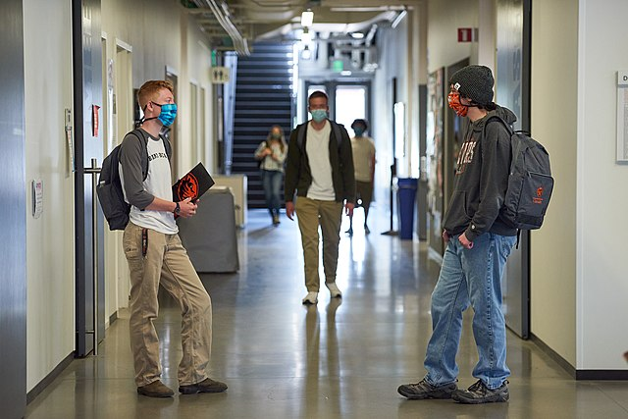
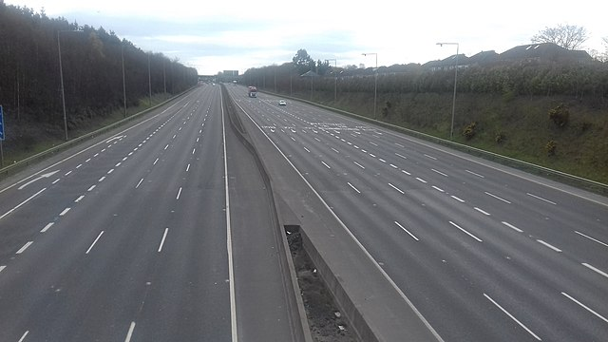

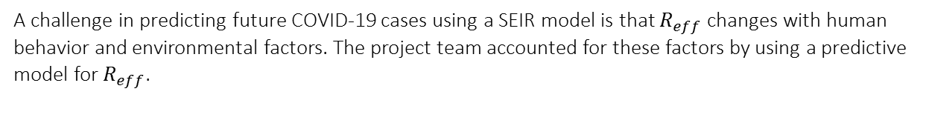
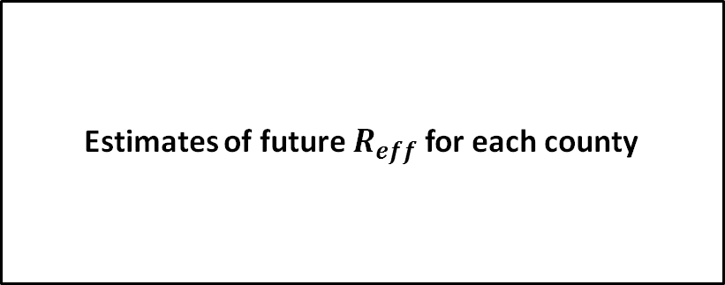
Modeling $R_{eff}$: Capturing Human and Environmental Impacts on the Spread of COVID-19
14 (out of 38 total) Variables
A challenge in predicting future COVID-19 cases using a SEIR model is that $R_{eff}$ changes with human behavior and environmental factors. The project team accounted for these factors by using a predictive model for $R_{eff}$.
daily new cases
total confirmed cases
cases first difference
hospitalized
population size
population density
flu rate
latitude
bars closed
schools closed
grocery
workplace
parks
transit
case trends
population
Wikimedia Commons, the free media repository
https://www.davidvinuales.com/
seasonality
XGBoost Model powered by DataRobot
Estimates of future $R_{eff}$ for each county
state policy
population mobility
Notes:
A close relative of $β$ is the basic reproduction rate, $R_{0}$. $R_{0}$ represents the average number of new cases expected to be directly generated from a single case, assuming a totally-susceptible population. $R_{0}$ is a constant, theoretical basic reproduction rate—CDC estimates $R_{0}=2.5$—while $R_{eff}$ is the effective or observed basic reproduction rate given human and environmental factors. Determining $R_{eff}$ posed a challenge to developing a SEIR model that truly reflected the spread of the virus in the modeled regions. Therefore, the project team used predictive modeling techniques to project future values of $R_{eff}$ for each county based on many data covering human and environmental variables.
To project an effective transmission factor for date $t > 0$, the project team executed a multi-step process using observed data and relevant demographic characteristics. First, the project team inferred the value of $R_{\text{eff}}$ for every previous day in each modeled region since the pandemic began. Next, the project team fit a regression model that predicted $R_{\text{eff}}$ given appropriate input variables.
To calculate historical $R_{eff}$ the project team used the differential equations from the Susceptible, Infected, Recovered (SIR) model—a model similar to the SEIR, but without an Exposed bin. The equation is $β=–\frac{dS}{dt}/(S_{i}∗I_{i})$. After determining the values of $R_{eff}$ for previous days, the project team used these values as a response variable to train a model that predicted values of R_{eff} using a machine learning tool, DataRobot. DataRobot allows users to input cleaned, pre-processed data with indicated response and predictor variables creating hundreds of different models using dozens of different methods for a given training set of the data. DataRobot then recommends the model with the lowest error in the test set as the model or record. The project team implemented the trained model to predict future values of R_{eff}.
During the development phase, the CAA project team found that models created using Extreme Gradient Boosted Tree Regression with Early Stopping (Poisson loss)—also known as XGBoost—and Unsupervised Learning Features consistently performed the best when predicting values of R_{eff}. XGBoost is a tree regression and therefore does not create a linear function $\hat{y}=ax+b$ as in many of the more commonly known regression techniques. Boosted Tree regression starts by building one decision tree that makes a prediction. In this case, the value of $\ln\left(\hat{R_{\text{eff}}}\right)$. More specifically, XGBoost builds leaves minimizing residuals for each observation using any loss function of choice. The project team uses the DataRobot-suggested Poisson loss function, $L_{i}={R_{\text{eff}}}_{i}−e^{{\hat{y}}_{i}}$, where $\hat{y}$ is the result of the tree regression, $L_{i}$ is the Poisson Loss, and $i$ is the record in the dataset that corresponds to a unique county and day of pandemic combination. Additional leaves are added according to a user-defined maximum number of terminal leaves and a user-defined maximum tree depth.

Slide 9
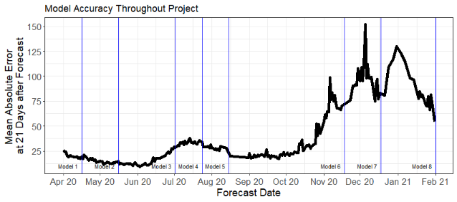
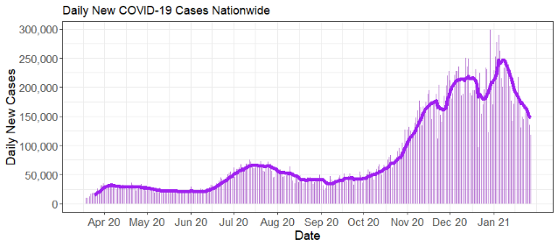
Validation and Verification: Continually Improving Modeling through Robust Performance Measurement
Robust code to track model versions distinguished by variables, parameter values, processing features, etc.
Continually developed model to improve accuracy. Eight official production model versions (shown in top graphic), with over 80 experimental model versions never published.
Automated error report identifies changing trends and updated model error metrics.
Wide variety of error metrics to capture a complex model and environment.
Notes:
The project team developed a robust validation and verification system.
Every day the model runs, it also produces an error report that highlights changes in COVID-19 trends over the previous month and examines multiple error metrics using multiple weighting criteria.
In general, the project team relied on four error metrics: root mean squared error, mean absolute error, mean absolute percent error, and mean percent error. These four metrics were enough to paint a well-rounded picture of model accuracy without overwhelming the viewer. Percent metrics were important because they measured the relative accuracy; however, in small counties with very few cases, percent error behaved in extreme ways. The absolute metrics, on the other hand, may have missed the relative accuracy but did a good job of capturing how close our model was in absolute numbers.
The top graphic on this slide displays the accuracy of the model over the course of the project—specifically, the mean absolute error at 21 days out from the forecast date. Each data point is taken from an individual model forecast. The blue vertical lines indicate the dates the project team transitioned to a new and improved model version. Without any changes to the model, the model absolute error would increase more or less proportionally to the increase in daily new cases, shown in the bottom graphic. However, one can see that as error started to increase during upward COVID-19 trends, the team transitioned to a more accurate model that lowered error or prevented it from continuing to rise with rising COVID-19 cases. This illustrates the project team’s constant adaptation to the COVID environment and constant effort to learn and improve the model.
In order to measure accuracy, the project team built the model to record model version. A model version is defined by the parameter values, function attributes, included variables, etc. If any of these characteristics changed, the model would record a new model version. The project team maintained the model to be able to run past model versions to ensure the project team was always using the most accurate model. The model was also capable of running predictions for past days. This allowed the project team to truly compare model version accuracy as if they ran on the same days.

Slide 10







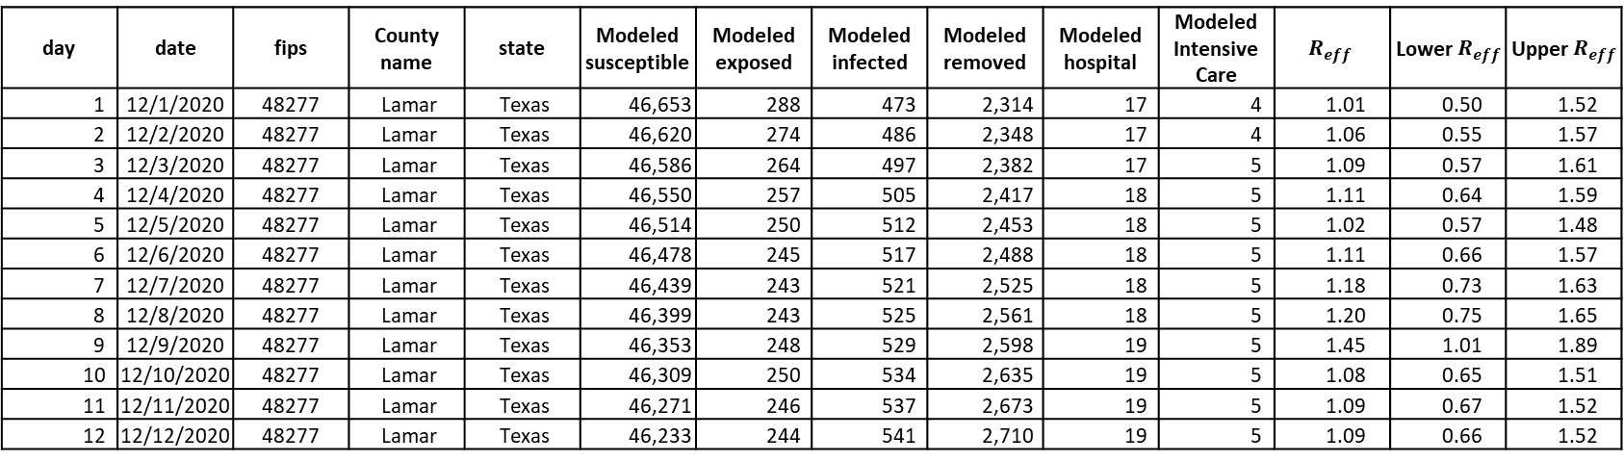
Conclusions and Impact: Usage and Impact Continually Expanded
Projection Day | Date | County Code | County Name | State | Modeled Susceptible | Modeled Exposed | Modeled Infected | Modeled Removed | Modeled Hospital | Modeled Intensive Care | $$R_{eff}$$ | Lower $R_{eff}$ | Upper $R_{eff}$
1 | 12/1/2020 | 48277 | Lamar | Texas | 46,653 | 288 | 473 | 2,314 | 17 | 4 | 1.01 | 0.50 | 1.52
2 | 12/2/2020 | 48277 | Lamar | Texas | 46,620 | 274 | 486 | 2,348 | 17 | 4 | 1.06 | 0.55 | 1.57
3 | 12/3/2020 | 48277 | Lamar | Texas | 46,586 | 264 | 497 | 2,382 | 17 | 5 | 1.09 | 0.57 | 1.61
4 | 12/4/2020 | 48277 | Lamar | Texas | 46,550 | 257 | 505 | 2,417 | 18 | 5 | 1.11 | 0.64 | 1.59
5 | 12/5/2020 | 48277 | Lamar | Texas | 46,514 | 250 | 512 | 2,453 | 18 | 5 | 1.02 | 0.57 | 1.48
6 | 12/6/2020 | 48277 | Lamar | Texas | 46,478 | 245 | 517 | 2,488 | 18 | 5 | 1.11 | 0.66 | 1.57
7 | 12/7/2020 | 48277 | Lamar | Texas | 46,439 | 243 | 521 | 2,525 | 18 | 5 | 1.18 | 0.73 | 1.63
8 | 12/8/2020 | 48277 | Lamar | Texas | 46,399 | 243 | 525 | 2,561 | 18 | 5 | 1.20 | 0.75 | 1.65
9 | 12/9/2020 | 48277 | Lamar | Texas | 46,353 | 248 | 529 | 2,598 | 19 | 5 | 1.45 | 1.01 | 1.89
10 | 12/10/2020 | 48277 | Lamar | Texas | 46,309 | 250 | 534 | 2,635 | 19 | 5 | 1.08 | 0.65 | 1.51
11 | 12/11/2020 | 48277 | Lamar | Texas | 46,271 | 246 | 537 | 2,673 | 19 | 5 | 1.09 | 0.67 | 1.52
12 | 12/12/2020 | 48277 | Lamar | Texas | 46,233 | 244 | 541 | 2,710 | 19 | 5 | 1.09 | 0.66 | 1.52
Notes:
The initial output from the SEIR model is a table that shows the number of people in a region population in each of the four SEIR bins on each future day for each county as well as related hospital stress data.
In March 2020, CAA began sharing model results during Army synchronization meetings, the Army’s routine platform for sharing information across leaders generally at the 3-star level the Army enterprise. By the end of April 2020, over 11 organizations requested and received CAA model results daily. These organizations integrated CAA results into decision support tools, situational awareness, and organization-specific analysis. Each time CAA took on a new consumer, CAA expanded the modeling capabilities and created new products to best enable these organizations. Organizations that consumed our model results and additional analysis products included:
Vice Chief of Staff of the Army for his situational awareness. He explicitly relied on CAA to inform him not only of its own analysis but on modeling efforts across the Army. He also dictated that CAA’s model would be the Army’s model of record by including it in the Army Vantage COVID-19 Dashboard.
G3/5/7, Headquarters, Department of the Army, who was charged with the Army COVID-19 Campaign Plan
U.S. Army North & Engineer Research and Development Center used project team predictions in their geospatial common operating picture to help them plan for FEMA’s emergency response in March and April 2020.
The staffs and commanders of U.S. Indo-Pacific Command (USINDOPACOM) and U.S. Army Pacific made decisions on when and where to resume USINDOPACOM training and exercises with partners and allies.
White House COVID-19 Task Force took an interest in CAA’s modeling techniques and results. CAA attended weekly meetings to keep the task force informed of analytical developments.
Defense Threat Reduction Agency used heat maps and model results to build their common operation picture to facilitate their leaders’ situational awareness.

Slide 11
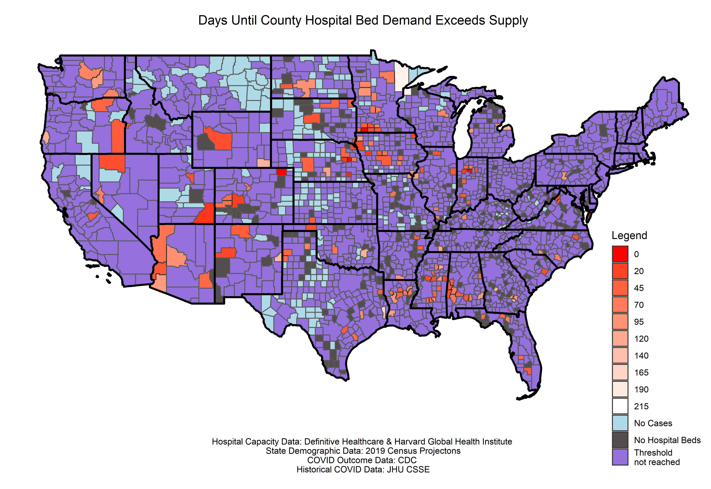
Conclusions and Impact: Informing USACE on Medical Infrastructure Demand
The CAA project team’s conclusions on medical infrastructure, along with models from USACE informed FEMA and USARNORTH decisions on where to build deployable field hospitals.
Days Until Core Based Statistical Area Hospital Bed Demand Exceeds Supply
Projection Date: 5 May
Legend (in days)
Hospital Capacity Data: Definitive Healthcare and Harvard Global Health Institute
State Demographic data: 2019 Census Projections
COVID-19 Outcome data: Centers for Disease Control and Prevention (CDC)
Historical COVID-19 Data: Johns Hopkins University
Notes:
CAA addressed requirements for medical intervention as a result of COVID-19-related infection as a sub-process rather than as an element of the main SEIR model. This is appropriate because epidemiological models are designed to represent disease spread through a population rather than the particular effect of that disease on individuals.
CAA used age cohort aligned rates for non-invasive inpatient hospitalization, intensive care unit (ICU) hospitalization, and case-fatality provided by the CDC. The CDC published expected hospitalization rates by age group. With those estimates, the project team estimated county hospitalization rates based on each county’s age distribution according to the U.S. Census Bureau.
The project team multiplies these rates by the population proportion in the infected bin each day to estimate the demand on medical infrastructure. This produces forecast demand by day for each county, irrespective of actual medical infrastructure capacity within the county.
$$hospitalized_{j}=I_{j}\left(t\right)∗hospitalization.rate_{j}$$
$${ICU}_{j}=I_{j}\left(t\right)∗ICU.rate_{j}$$
Separately, CAA collected data on available hospital beds and intensive care beds in each county. From the hospitalization forecasts and these available-bed estimates, the project team projected the date on which hospitals would become overwhelmed.

Slide 12
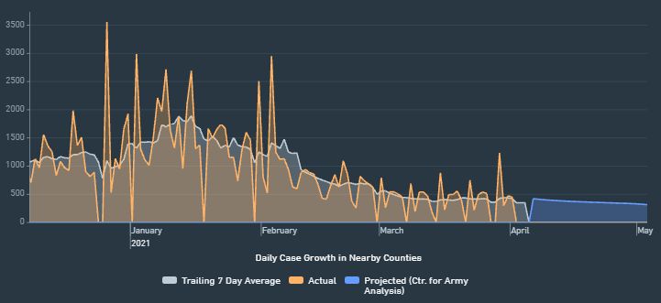
Conclusions and Impact: Sharing the Army’s Model of Record to a Wide Audience
The project team was the lead office providing shared understanding to Army senior leaders in HQDA. The Vice Chief of Staff (VCSA) declared CAA’s model the official Army model for Army leaders.
The team:
Clarified the COVID-19 analytical space for the Under Secretary of the Army and VCSA.
Provided regular projections and analysis directly to 3-star leaders across the Army Enterprise.
Enabled risk and opportunity assessments at-echelon through projection publication on the U.S. Army Vantage COVID-19 Leader Dashboard.
U.S. Army Vantage COVID-19 Dashboard Snapshot
Notes:
Army Vantage is a data management platform designed to integrate data from hundreds of DoD systems in any form at any scale. It provides leaders at all echelons across the Army a tool to consolidate, analyze, and visualize data. The COVID-19 dashboard is one feature of the entire system that provides leaders with near-real-time and local information on COVID-19.
The Vice Chief of Staff of the Army and other leaders felt that the CAA model results were so valuable that they should be shared instantly down to the lowest level of command. They used Army Vantage to do this. This meant that a battalion commander at Fort Bragg, for instance, had access to CAA’s model projections for Fort Bragg and the surrounding area to help him/her make decisions about training, prevention, and mitigation measures that he/she could control.

Slide 13
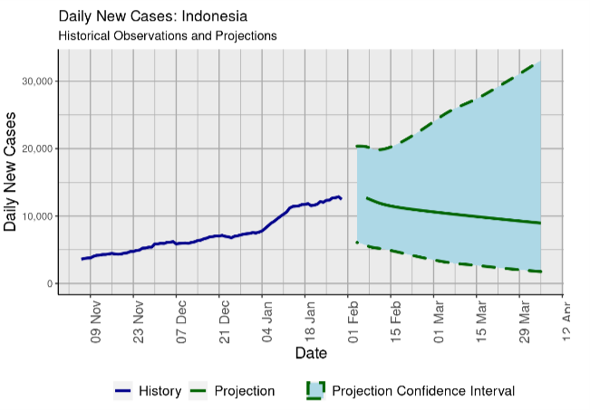
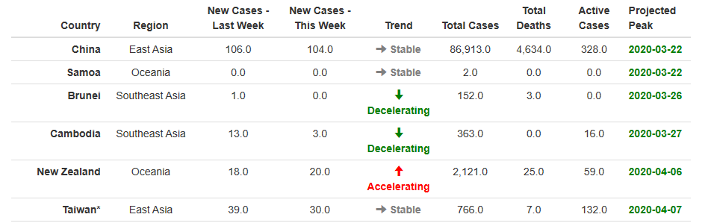
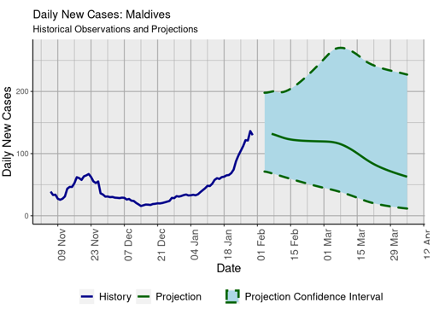
Conclusions and Impact: Influencing Beyond HQDA, USINDOPACOM
USINDOPACOM and U.S. Army Pacific (USARPAC) used the projections to decide when and where to conduct engagements or training exercises in foreign countries.​
USINDOPACOM staff briefed weekly reports to commanders, senior leaders, and ambassadors to maintain situational awareness and to support decision-making efforts.
Projections enabled effective anticipation of required military support to COVID-19 mitigation efforts in U.S. territories.
Notes:
Modeling capabilities were shared with USINDOPACOM who requested the project team create models for all 53 countries and U.S. territories in its area of responsibility. To model these countries, CAA assumed that these countries (including very large countries) exhibit similar viral spread patterns to U.S. counties. The project team undertook extensive data collection efforts and model-development efforts to incorporate these countries. In addition to detailed model tables, the project team produced an automated weekly report including tables and figures that communicated recent historical trends and CAA’s future projections.

Slide 14
Chapter 2: Answering Policy and Resource Management Questions Using SEIR Models

Slide 15
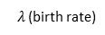
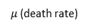
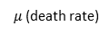
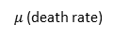
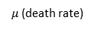
Objectives and Analytical Framework: Research Questions and A-vs-B SEIR Model Comparisons
Consumers of CAA analysis
U.S. Army Central (USARCENT)
USINDOPACOM
U.S. Special Operations Command (SOCOM)
Chapter 2
What non-pharmaceutical interventions best slow the spread of COVID-19 at Army bases?
What is the risk of importing a case under various individual deployment scenarios?
How should the arrival quarantine procedures change for individually vaccinated deplorers?
How many medical supplies should USARCENT order for Military Treatment Facilities (MTFs)?
SEIR Model given policy A
vs.
SEIR Model given policy B
$λ$(birth rate)
$λ$(birth rate)
S(t)
E(t)
I(t)
U(t)
S(t)
E(t)
I(t)
U(t)
Susceptible: As-yet unaffected by virus
Exposed: Incubating, not yet contagious
Infected: Contagious virus carriers
Removed: No longer susceptible, post-infected individuals
Susceptible: As-yet unaffected by virus
Exposed: Incubating, not yet contagious
Infected: Contagious virus carriers
Removed: No longer susceptible, post-infected individuals
$μ$(death rate)
$μ$(death rate)
$μ$(death rate)
$μ$(death rate)
$μ$(death rate)
$μ$(death rate)
$μ$(death rate)
$μ$(death rate)
Notes:
In the summer of 2020, there were regional surges of COVID-19, but already feelings were beginning to surface that “the worst of this is over.” Senior leaders were still very interested in COVID-19, but were beginning to think beyond how they could support the national response. Instead, they were focusing on what the Army needed to do to accomplish its mission in a COVID-19 environment.
The connections the project team had made through its initial COVID-19 work in combination with informal networking actions by other CAA personnel led to new types of questions from organizations such as USARCENT, USINDOPACOM, and Operation GALLANT PHOENIX.
The project team used the SEIR model in a projection capacity to answer policy and research questions such as:
What non-pharmaceutical interventions should be implemented to slow the spread of COVID-19 at Army bases?
What is the risk of importing a COVID-19 case under various individual deployment scenarios?
How should the arrival quarantine procedures change for individual vaccinated deplorers?
How many cases and hospitalizations should USARCENT expect at military treatment facilities in the future? How does that impact the quantity of medical supplies ordered?
How do different strains of COVID-19 impact the long-term future of COVID-19 in various regions?
This presentation dives deeply into the fourth of these analytical questions and the project team’s methods to answer it: how the project team made recommendations to USARCENT regarding how many medical supplies to order for their hospitals.
Methodology: Use population-tailored SEIR projection models to conduct A vs. B experiments under different assumptions and parameters to answer policy and resource-management questions.

Slide 16
Projecting Medical Requirements for USARCENT: Identifying the Problem and the Need for a Stochastic SEIR Model
Problem: USARCENT G4 was ordering medical supplies based on an internal model that used CDC estimates. This resulted in far too many supplies on hand, but USARCENT did not know by how much to reduce their supply orders.
Analytical Challenges:
Small number of recorded cases made modeling difficult.
Population of USARCENT is different from general U.S. population. National planning parameters from CDC were not accurate in this scenario.
Analytical Framework
Calculate historic $R_{eff}$ for USARCENT
Calculate historic 𝑅_𝑒𝑓𝑓 for USARCENT
1000 SEIR iterations with randomly selected historic $R_{eff}$ values
1000 SEIR iterations with randomly selected historic 𝑅_𝑒𝑓𝑓 values
Select 95th percentile outcome as worst-case planning scenario
Project medical system demands for worst-cast scenario
Notes:
USARCENT approached the project team with a number of problems, but the most pressing for them was their medical supply issues. They had warehouses full of masks, gloves, and gowns. They were using a scheme based loosely on COVID-19 models and CDC ordering guidance, but done in such a way that caused massive over-orders.
One of the first challenges in this problem was accounting for the difference in demographic profiles between USARCENT and the general U.S. population. So, the project team researched model parameters tailored to this population instead of relying on CDC parameter estimates for the general U.S. Population.
In addition to modeling a different population, the project team had to address the small size of the modeling locations. Most of these locations had lengthy stretches with no cases followed by small outbreaks that would die out in the span of a few weeks. This made predicting future values of $R_{eff}$ very challenging.
To solve this problem the project team decided to not predict but sample future values of $R_{eff}$ from past values. The project team simulated the SEIR model 1,000 times, each time choosing a random historical $R_{eff}$ value for each forecasted day within the model run. This resulted in a distribution of possible COVID-19 outcomes for the USARCENT population from which the project team chose the outcome from the 95th percentile. Since having too few medical supplies is much worse than having too many, the outcome from the 95th percentile simulation based on total cases were designated as a conservative planning scenario.

Slide 17
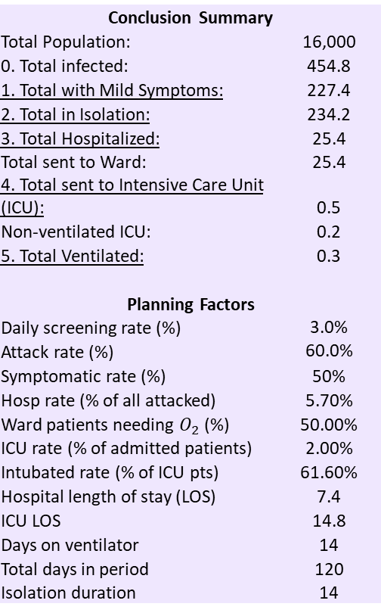
Projecting Medical Requirements for USARCENT: Conclusions for USARCENT
The project team developed projections by collecting data on military populations and estimating parameters better aligned with USARCENT’s population.
Conclusion Summary
Total Population: | 16,000
0. Total infected: | 454.8
1. Total with Mild Symptoms: | 227.4
2. Total in Isolation: | 234.2
3. Total Hospitalized: | 25.4
Total sent to Ward: | 25.4
4. Total sent to Intensive Care Unit (ICU): | 0.5
Non-ventilated ICU: | 0.2
5. Total Ventilated: | 0.3
Planning Factors
Daily screening rate (%) | 3.0%
Attack rate (%) | 60.0%
Symptomatic rate (%) | 50%
Hosp rate (% of all attacked) | 5.70%
Ward patients needing $O_{2}$ (%) | 50.00%
ICU rate (% of admitted patients) | 2.00%
Intubated rate (% of ICU pts) | 61.60%
Hospital length of stay (LOS) | 7.4
ICU LOS | 14.8
Days on ventilator | 14
Total days in period | 120
Isolation duration | 14
Notes:
The project team addressed the challenge of modeling a different population by altering hospitalization rates. Information from an Army Public Health Center (APHC) dataset had information about every COVID-19 case treated at a military treatment facility. The tailored parameters for hospitalization rates and lengths of stay were derived from this dataset.
From the results of the SEIR model and the refined hospitalization rates, the project team estimated the subsets of cases that were symptomatic, required hospitalization, and required intensive-care treatment. The project team further calculated the number of cumulative days COVID-19 patients were expected to stay in hospitals and how much they would consume in medical supplies. This gave USARCENT a more accurate expectation of how many medical supplies to order for a 4-month period.

Slide 18
Projecting Medical Requirements for USARCENT: Impact on USARCENT Medical Supply Orders
As a result of the project team’s work, USARCENT drastically lowered ordering rate of medical supplies, saving money and space in warehouses.
 | Kuwait
Medical Supplies​ | Updated | Initial | Reduction
Masks | 2,987 | 43,790 | 93%
Gloves | 5,116 | 272,880 | 98%
Gowns | 308 | 32,040 | 99%
Eye Protection | 4 | 452 | 99%
N95 Respirator | 216 | 23,160 | 99%
Notes:
The project team provided its conclusions to the USARCENT G4 section, who presented it as part of a decision brief to the USARCENT Deputy Commander regarding the size of the medical supply orders. The tables on this slide show the project team’s recommended amount (labeled “Updated”), the initial amount the USARCENT was ordering, and the percent reduction in which our recommendation resulted. The reduction is generally >95% and resulted in significant savings of cost to the unit and space in warehouses.

Slide 19
Chapter 3: Developing New Models to Answer Training and Deployment Questions

Slide 20
Objectives and Analytical Framework: Research Questions and an Agent-Based SEIR Model
Consumers of CAA analysis
U.S. Army Forces Command (FORSCOM)
SOCOM
Chapter 3
What is the best testing policy for units going to CTC exercises?
What is the risk of a COVID-19 outbreak on a deployed base?
Notes:
In late summer of 2020, as the project team began answering more policy and resource questions, they anticipated new questions from senior leaders. The project team understood that commanders wanted to get back to training and deploying as normal just like most Americans wanted life to get back to normal. However, to accurately model COVID-19 spread in an Army unit, the traditional SEIR model they were using in Chapters 1 and 2 would not be appropriate. The traditional SEIR model cannot account for inter-person variability, has difficulty modeling with small population sizes, and struggles to provide meaningful probabilistic forecasts. Therefore, the project team, in collaboration with APHC and Lawrence Livermore National Labs (LLNL), embarked on building an agent-based model to simulate COVID-19 spread in small, close-knit organizations.
After some initial work, the project team, on behalf of the greater collaborative effort, approached U.S. Army Forces Command (FORSCOM) and received positive interest, specifically as it related to how this work applied to units deploying and training at the combat training centers.
Over time, the CAA project team, LLNL, and APHC refined the model to be able to accurately reflect units in training or deployed. CAA used it to help inform FORSCOM regarding improvements in their testing policies at Combat Training Centers (CTCs).
Separately, a CAA-forward deployed analyst with Operation GALLANT PHOENIX relayed COVID-19-related questions from their base commander related to quantifying outbreak risk at their base.
This presentation will focus only on how this model was used to help FORSCOM shape CTC testing policies.
Methodology: Provide operational, COVID-19, and mathematical expertise in LLNL’s development of an agent-based, stochastic, individual-contact model used to simulate the spread of COVID-19 in a military unit during training and/or deployment.

Slide 21



Improving CTC COVID-19 Testing Procedures: Identifying the Problem and the Need for an Agent-Based Model
Problem: Despite testing all personnel for COVID-19 prior to a CTC rotation, training units still experienced significant incidences of COVID-19. FORSCOM was interested in determining whether other testing and pre-travel restriction-of-movement protocols could lead to better outcomes (i.e., reduce the number of soldiers who contract COVID-19 during training and reduce the number of soldiers who miss training due to quarantine).
Analytical Challenges:
A COVID-19 outbreak in a military unit will not spread uniformly, but will tend to pool in isolated units.
The small size of the population makes various individual disease profiles much more influential in model outcomes.
Modeling experience, COVID-19 knowledge, Army operational experience
COVID-19 outcomes under Policy A
COVID-19 Agent-Based Model
High performance computing, probabilistic modeling expertise, coding expertise
COVID-19 outcomes under Policy B, C, D
Epidemiological expertise, COVID-19 testing expertise
Notes:
Because even COVID-19 polymerase chain reaction (PCR) tests—considered the gold standard for tests—cannot detect immature infections, even conducting a 100% test just prior to training will not prevent all cases. This causes two problems: 1) Soldiers get sick with COVID-19 and 2) when a Soldier presents with symptoms and subsequently tests positive during the training event, all of his/her first tier contacts must quarantine. This results in lost training time.
CAA, LLNL, and APHC simulated various testing protocols looking for different outcomes that minimized both lost training time due to quarantined Soldiers and the total number of Soldiers that contracted COVID-19.
In order to construct this model, the multi-agency team had to address the challenges of non-uniform spread. If a Soldier in an infantry platoon contracts COVID-19, it is highly likely that it spreads within the platoon, because they all interact with each other daily or hourly. However, it is unlikely that the infection spreads to, say, the brigade headquarters because there is little interaction between Soldiers of an infantry platoon and brigade headquarters. Only the network structure inherent in an agent-based model can reflect this reality. CAA built an interaction matrix based on a 4,100-soldier brigade combat team’s table of organization and equipment.
Additionally, because these scenarios start with only 1-20 infected Soldiers, it is important to reflect the random variations in disease course. An infected person could become contagious in just a few days, or it might take over a week. Similarly, a person might remain contagious for only a few days, or might be contagious for 10-14 days. Modeling this reality is important when using probabilistic forecasting to make planning decisions.
After completing the model, the multi-agency team could run simulations with different testing protocols and examine the results.

Slide 22
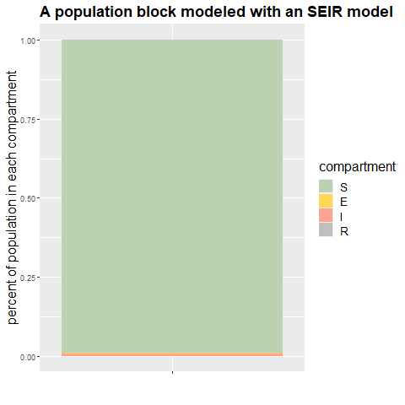
Improving CTC COVID-19 Testing Procedures: Need for an Agent-Based Model
Susceptible: As-yet unaffected by virus
Exposed: Incubating, not yet contagious
Infected: Contagious virus carriers
Removed: No longer susceptible, post-infected individuals
The SEIR model focuses on groups of people, assuming perfect intermixing and uniform disease profiles.
An agent-based model focuses on individuals, each with unique interaction patterns and disease profiles.
Susceptible
Infected
Removed / Recovered
Displaying Symptoms
Quarantined
Notes:
Compared to the differential-equation SEIR models in Chapter 1 and 2, an agent-based SIR model. An agent-based model is capable of capturing individual disease profiles, producing a more accurate COVID-19 forecast in small, closed populations that interact in a non-uniform ways.
The SEIR model from Chapters 1 and 2 looks at population groups, not individuals.
Every person who contracts COVID-19 incubates the disease for 6 days before becoming contagious; then, he/she is contagious for 14 days.
Every person is equally likely to contact every other person in the closed population.
The SEIR model does not for whether a case is symptomatic or asymptomatic.
The SEIR model does not account for intervention, such as contact tracing or quarantines.
The agent-based SIR model in Chapter 3 reflects individual actions and disease profiles as closely as possible.
Some individuals who get COVID-19 are contagious for short periods, others much longer.
Interactions are based on the organizational chart of a Brigade Combat Team.
A user-defined percent of cases present with symptoms; a random variable governs the time lag between exposure and symptoms.
The agent-based SIR is capable of simulating interventions or changes in interaction patterns, such as contact tracing and quarantines.

Slide 23
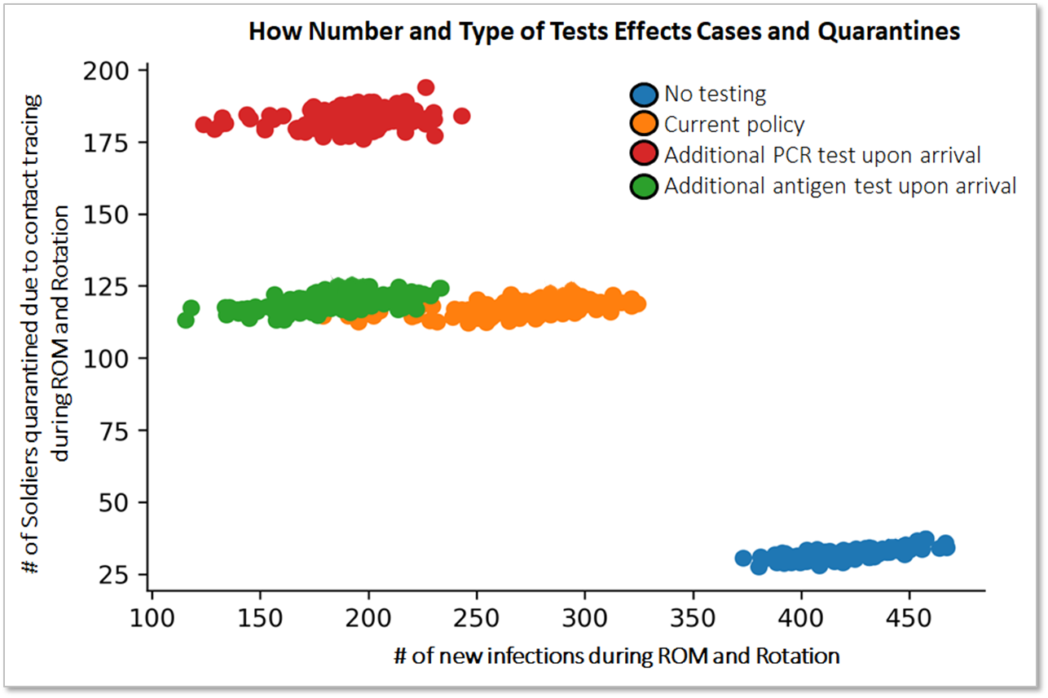
Improving CTC COVID-19 Testing Procedures: Impact on FORSCOM and SOCOM
The study team briefed results and analysis to the deputy commander of FORSCOM and staff from the FORSCOM Surgeon's office. FORSCOM is now utilizing antigen testing prior to CTC rotations.
The project team used this model to support SOCOM decisions to reduce pre-travel restriction of movement (ROM) periods.
Notes:
As a preliminary exploration, the multi-agency team examined four testing protocols, in the graphic the X-axis represents how many new COVID-19 infections occurred, and the Y-axis represents the number of Soldiers that had to quarantine. Of note, a large number of the infections are asymptomatic and occur during the training event, so they are not detected.
The blue dots represent a less restrictive testing policy, where no surveillance testing is conducted. This results in ~10% of Soldiers contracting COVID-19 during the training event, but very few quarantines, because so few cases are detected.
The orange dots represent current results, where a single 100% PCR test is administered 5 days before traveling to the CTC. This results in ~6% of Soldiers contracting COVID-19, but ~3% having to quarantine.
The multi-agency team then examined adding a second 100% surveillance test. The red dots represent adding an additional PCR test, while the green dots represent adding an additional rapid antigen test, which is less sensitive but returns results faster.
Adding a second rapid antigen test after arrival at the CTC yielded simulation results with ~33% reduction in total cases when compared to the current policy without increasing quarantines. This is due to the more focused nature of the rapid antigen test, which typically returns a positive result only for people who are currently contagious. The PCR test can return positive results for people that were, but are no longer contagious, as well as those who have COVID-19, but are not yet contagious.

Slide 24
Conclusion

Slide 25
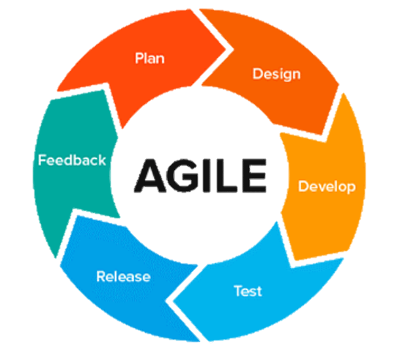







Innovation: Overcoming Technical Limitations by Adopting Unfamiliar Tools
Fully Remote Development Security Operations:
Cutting Edge tools and
Data Analytics:
Modern Deployment Stack:
SEIR
Cloud Programming Budget and Execution
Notes:
The project team used modern data science and software development methods and techniques to overcome several challenges.
Running the model. As the project team developed and expanded the model functions, it took hours to run all of it at once on a single analyst’s laptop. The team needed a way to free up their laptop time to allow them time to spend on valuable development and analysis efforts. They addressed this through the following means:
Highly flexible but resource-intensive XGBoost machine learning model performed well for $R_{eff}$ predictions; the system automatically trained, tuned, and validated using DataRobot with processing units operating on the cloud and in parallel.
The project team fully automated all data downloads and $R_{eff}$ DataRobot model runs using Application Programming Interfaces (APIs) called from $R_{eff}$.
The project team moved the entire modeling process to a cloud (cPROBE RStudio Server) and fully automated them with cron, a utility program for repeating tasks at a later time. The entire modeling process included downloading data; cleaning the data; running the SEIR model on over 3,000 counties and countries; building a quality control report; building products, charts, maps, reports, and tables; and sharing or uploading products to various destinations.
As soon as this project began, the project team moved to exclusively telework, which posed new project management and technical challenges. To address these challenges, the team used new tools and began following a then-unfamiliar project management methodology called Agile.
The project team used GitLab, which is a DoD-provided, CUI-approved platform for code hosting and version control.
The project team was the first at CAA to follow an Agile project management methodology, which helped ensure better communication among a distributed project team, increased visibility of work and progress, and faster adjustment to changing sponsor needs and pandemic situation.
Sharing conclusions in the format most useful for customers on a daily basis was time consuming, so the project team found ways to save precious analytical time.
The project team developed code to automatically upload daily model results to the Army Vantage COVID-19 Dashboard.
The project team shared one product in a particularly unique and automated way. The project team developed the model to deploy a hospital capacity warning report to RStudio Connect with automatic email notifications directly to the customer, USINDOPACOM. USINDOPACOM staff received a weekly email providing the quantified real-time risk level for certain countries based on recent COVID-19 trends and model results.
These efficiencies combined with an Agile project management framework allowed the project team to continuously adapt to a changing environment, and changing senior leader priorities and ultimately enabled this wide breadth of influence.

Slide 26
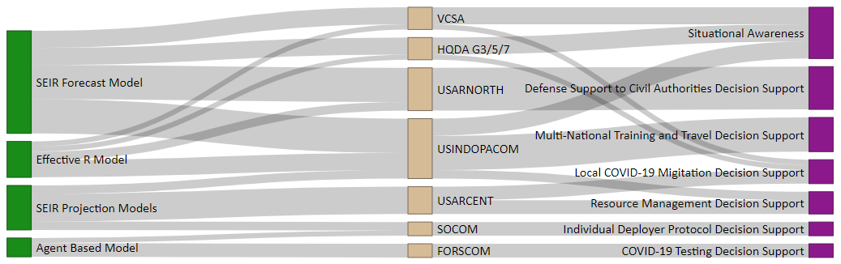
Impact Revisited
What analysis CAA produced
How customers used analysis
Customers
“CAA’s understanding of the senior leadership decision environment and their ability to communicate within it has allowed me to understand the impact of COVID-19 better and make well-informed decisions.” GEN Joseph M. Martin, 37th VCSA
Notes:
The project team built three types of models, a SEIR forecasting model for all U.S. Counties and USINDOPACOM countries; multiple SEIR projection models to examine “what if” scenarios; and, through a multi-agency partnership, an agent-based model to examine COVID-19 spread in small military units.
This suite of models had a massive breadth of impact, from shaping arrival protocols for small forward bases, to mobilization of National Guard units to conduct civil support operations, to decision about conducting multi-national training operations.
A non-exhaustive list of decisions influenced is below.​
When and where to deploy field hospitals in CONUS and U.S. territories in the INDOPACIFIC region?​
Approval multi-national training exercises and official travel?​
How long should individual deployers have to quarantine upon arrival to theater?​
How and when should FORSCOM units conduct surveillance testing prior to CTC rotations?​
How many medical supplies should USARCENT order?​
What base policies should USARCENT implement to slow the spread of COVID-19?​
There are countless other decisions that the study team partially or likely influenced, the above decisions are known to be influenced by the analysis of this team.

Slide 27
Data Sources (1 of 2)
Ch. 1
Ch. 2
Ch. 3
Ch. 1
Ch. 2
Ch. 3
Chapter Relevance | Data​ | Source Organization​ | Source Link​
 | Coronavirus confirmed cases​ by day for U.S. counties and foreign countries | USA Facts | https://usafacts.org/visualizations/coronavirus-covid-19-spread-map
 | Number of hospital ward and intensive care beds in each U.S. county ​ | Environmental Systems Research Institute​ | https://coronavirus-disasterresponse.hub.arcgis.com/datasets/definitivehc::definitive-healthcare-usa-hospital-beds/​
 | Number of hospital ward and intensive care beds in foreign countries | ​World Bank | https://data.worldbank.org/indicator/SH.MED.BEDS.ZS
 | Number of military treatment facility beds available | CarePoint | https://carepoint.health.mil/sites/COVID19_STATUS/Pages/mtf-bsr.aspx
 | Proportion of hospital beds available in each county | Liz Friedman published on Data.world | https://data.world/liz-friedman/hospital-capacity-data-from-hghi
 | Population & Age Distributions for foreign countries​ | Central Intelligence Agency World Fact Book​ | https://www.cia.gov/library/publications/the-world-factbook/​
 | Age distribution for each U.S. county | U.S. Census Bureau | data.census.gov, table customization tool
 | COVID-19 outcome rates (fatality, hospitalization, intensive care) | Department of Health and Human Services | Monthly published COVID-19 estimates document
 | Number of vaccinations by state | Our World in Data GitHub page | https://github.com/owid/covid-19-data/tree/master/public
 | Population for each U.S. county | U.S. Census Bureau | https://www.census.gov/data/datasets/time-series/demo/popest/2010s-counties-total.html#par_textimage_739801612
Ch. 1
Ch. 2
Ch. 3

Slide 28
Data Sources (2 of 2)
Chapter Relevance | Data​ | Source Organization​ | Source Link​
 | County size (land area) | U.S. Census Bureau | data.census.gov, table customization tool
 | State policies by day​ | ​Boston University School of Public Health | ​https://github.com/USCOVIDpolicy/COVID-19-US-State-Policy-Database.git
 | Movement data for each state | ​Google | https://www.google.com/covid19/mobility/
 | Geographic data​ (latitude and elevation) | ​National Oceanic and Atmospheric Administration, National Centers for Environmental Information | https://www1.ncdc.noaa.gov/pub/data/noaa/isd-history.txt
 | Flu/Pneumonia death by state and by week | ​CDC | https://www.cdc.gov/flu/weekly/weeklyarchives2020-2021/data/NCHSData09.csv available at https://www.cdc.gov/flu/weekly/index.htm#ILIActivityMap
 | COVID-19 testing data for each state | The COVID Tracking Project | https://covidtracking.com/data/download/all-states-history.csv available at https://covidtracking.com/data/download
 | Case, demographic, and hospitalization data for military personnel | Army Disease Reporting System | Data maintained and distributed via secure transfer by Army Public Health Center.
 | USARCENT historical COVID-19 case data | USARCENT | USARCENT controls data and shared it with CAA via secure transfer
 | Coronavirus confirmed cases​ by day for U.S. counties and foreign countries | Johns Hopkins University​ | https://coronavirus.jhu.edu/map.html​
Ch. 1
Ch. 2
Ch. 3
Ch. 1
Ch. 2
Ch. 3
Ch. 1
Ch. 2
Ch. 3

Slide 29
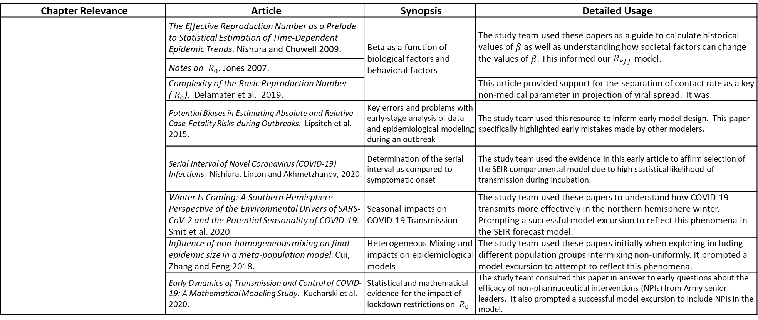
Literature Review (1 of 2)
Chapter Relevance | Article | Synopsis | Detailed Usage
 | The Effective Reproduction Number as a Prelude to Statistical Estimation of Time-Dependent Epidemic Trends. Nishura and Chowell 2009. | Beta as a function of biological factors and behavioral factors | The study team used these papers as a guide to calculate historical values of $β$ as well as understanding how societal factors can change the values of $β$. This informed our $R_{eff}$ model.
 | Notes on ${ R}_{0}$. Jones 2007.
 | Complexity of the Basic Reproduction Number (${ R}_{0}$). Delamater et al. 2019. |  | This article provided support for the separation of contact rate as a key non-medical parameter in projection of viral spread. It was
 | Potential Biases in Estimating Absolute and Relative Case-Fatality Risks during Outbreaks. Lipsitch et al. 2015. | ​Key errors and problems with early-stage analysis of data and epidemiological modeling during an outbreak | The study team used this resource to inform early model design. This paper specifically highlighted early mistakes made by other modelers.
 | Serial Interval of Novel Coronavirus (COVID-19) Infections. Nishiura, Linton and Akhmetzhanov, 2020. | Determination of the serial interval as compared to symptomatic onset | The study team used the evidence in this early article to affirm selection of the SEIR compartmental model due to high statistical likelihood of transmission during incubation.
 | Winter Is Coming: A Southern Hemisphere Perspective of the Environmental Drivers of SARS-CoV-2 and the Potential Seasonality of COVID-19. Smit et al. 2020 | ​Seasonal impacts on COVID-19 Transmission | The study team used these papers to understand how COVID-19 transmits more effectively in the northern hemisphere winter. Prompting a successful model excursion to reflect this phenomena in the SEIR forecast model.
 | Influence of non-homogeneous mixing on final epidemic size in a meta-population model. Cui, Zhang and Feng 2018. | Heterogeneous Mixing and impacts on epidemiological models | The study team used these papers initially when exploring including different population groups intermixing non-uniformly. It prompted a model excursion to attempt to reflect this phenomena.
 | Early Dynamics of Transmission and Control of COVID-19: A Mathematical Modeling Study. Kucharski et al. 2020. | Statistical and mathematical evidence for the impact of lockdown restrictions on ${ R}_{0}$ | The study team consulted this paper in answer to early questions about the efficacy of non-pharmaceutical interventions (NPIs) from Army senior leaders. It also prompted a successful model excursion to include NPIs in the model.
Ch. 1
Ch. 2
Ch. 3
Ch. 1
Ch. 2
Ch. 3
Notes:
While research-focused members of the team consulted many more academic resources than just those listed here, the above list is condensed to include only the key articles that shaped and justified the decisions regarding model design assumptions, parameter selection, and model improvement. In total, our research team consumed more than 300 articles and pre-print publications from peer-reviewed academic journals while remaining responsive to requests from the Army staff to explain and frame the early stage of models, forecasts and estimates being provided by various governmental, academic, and media sources. As the pandemic progressed, the study team continued to stay on top of developments from other Army and DoD modeling and analysis efforts, breakthroughs and resources from the medical community, and the state of medical best practices for treatment as related to constrained medical supplies.

Slide 30
Literature Review (2 of 2)
Chapter Relevance | Article | Synopsis | Detailed Usage
 | Forecasting versus projection models in epidemiology: The case of the SARS epidemics. Massad, 2005. | Overview of Basic Epidemiology Models | The study team used this paper as one of the first sources to help provide basic information about how to use SEIR type models to forecast future cases during an epidemic.
 | The Incubation Period of Coronavirus Disease 2019 From Publicly Reported Confirmed Cases: Estimation and Application. Lauer et al. 2020. | Understanding epidemiological parameter values | ​The study team used this papers to understand the different parameter values in SIR type models as they related to COVID-19. These parameter values ended up being used in the SEIR forecast model.
 | Temporal Dynamics in Viral Shedding and Transmissibility of COVID-19. He et al. 2020 | ​Probabilistic distributions for epidemiological parameter values | The Lauer paper provided information on point estimates for parameter values. However, to implement an agent based model with individual disease profiles, these parameters needed to be defined with probabilistic distributions. These papers collectively enabled the study team to encode various parameter distribution in the agent based model.
 | Estimating the false negative probability of SARS-CoV-2 by RT-PCR. Wikramaratna, Paton and Ghafari 2020.
 | A Quantitative Compendium of COVID-19 Epidemiology. Bar-on et al. 2020
 | A Three-Scale Network Model for Early Growth Dynamics of 2014 West Africa Ebola Epdemic. Kiskowski 2014. | ​Implementing an agent-based SIR model using a contact network with varying contact levels | The study team used this as a primer for building the agent based model. It eventually impacted the decision on how to structure the network model that governed agent interactions in that model.
Ch. 1
Ch. 2
Ch. 3
Ch. 1
Ch. 2
Ch. 3
Ch. 1
Ch. 2
Ch. 3

Slide 31
Acronyms
(U) AMC – Army Materiel Command
(U) CAA – Center for Army Analysis
(U) CDC – Centers for Disease Control and Prevention
(U) COVID-19 – Coronavirus disease 2019
(U) cPROBE – Cloud Programming Budget and Execution
(U) CTC – Combat Training Center
(U) DoD – Department of Defense
(U) DTRA – Defense Threat Reduction Agency
(U) ERDC – Engineer Research and Development Center
(U) FEMA – Federal Emergency Management Agency
(U) FORSCOM – U.S. Army Forces Command
(U) HQDA – Headquarters, Department of the Army
(U) ICU – Intensive Care Unit
(U) JHU – Johns Hopkins University
(U) LOS – Length of Stay
(U) MORS – Military Operations Research Society
(U) MTF – Military Treatment Facility
(U) NPI – Non-Pharmaceudacal Intervention
(U) PANDAS – Pandemic Analysis for Senior Leaders
(U) ROM – Restriction of movement
(U) SEIR – Susceptible Exposed Infected Removed Model
(U) SIR – Susceptible Infected Removed
(U) SOCOM- U.S. Special Operations Command
(U) USA – U.S. Army
(U) USACE – U.S. Army Corps of Engineers
(U) USARCENT – U.S. Army Central
(U) USARNORTH – U.S. Army North
(U) USARPAC – U.S. Army Pacific
(U) USINDOPACOM – U.S. Indo-Pacific Command
(U) VCSA – Vice Chief of Staff

